Slide 1
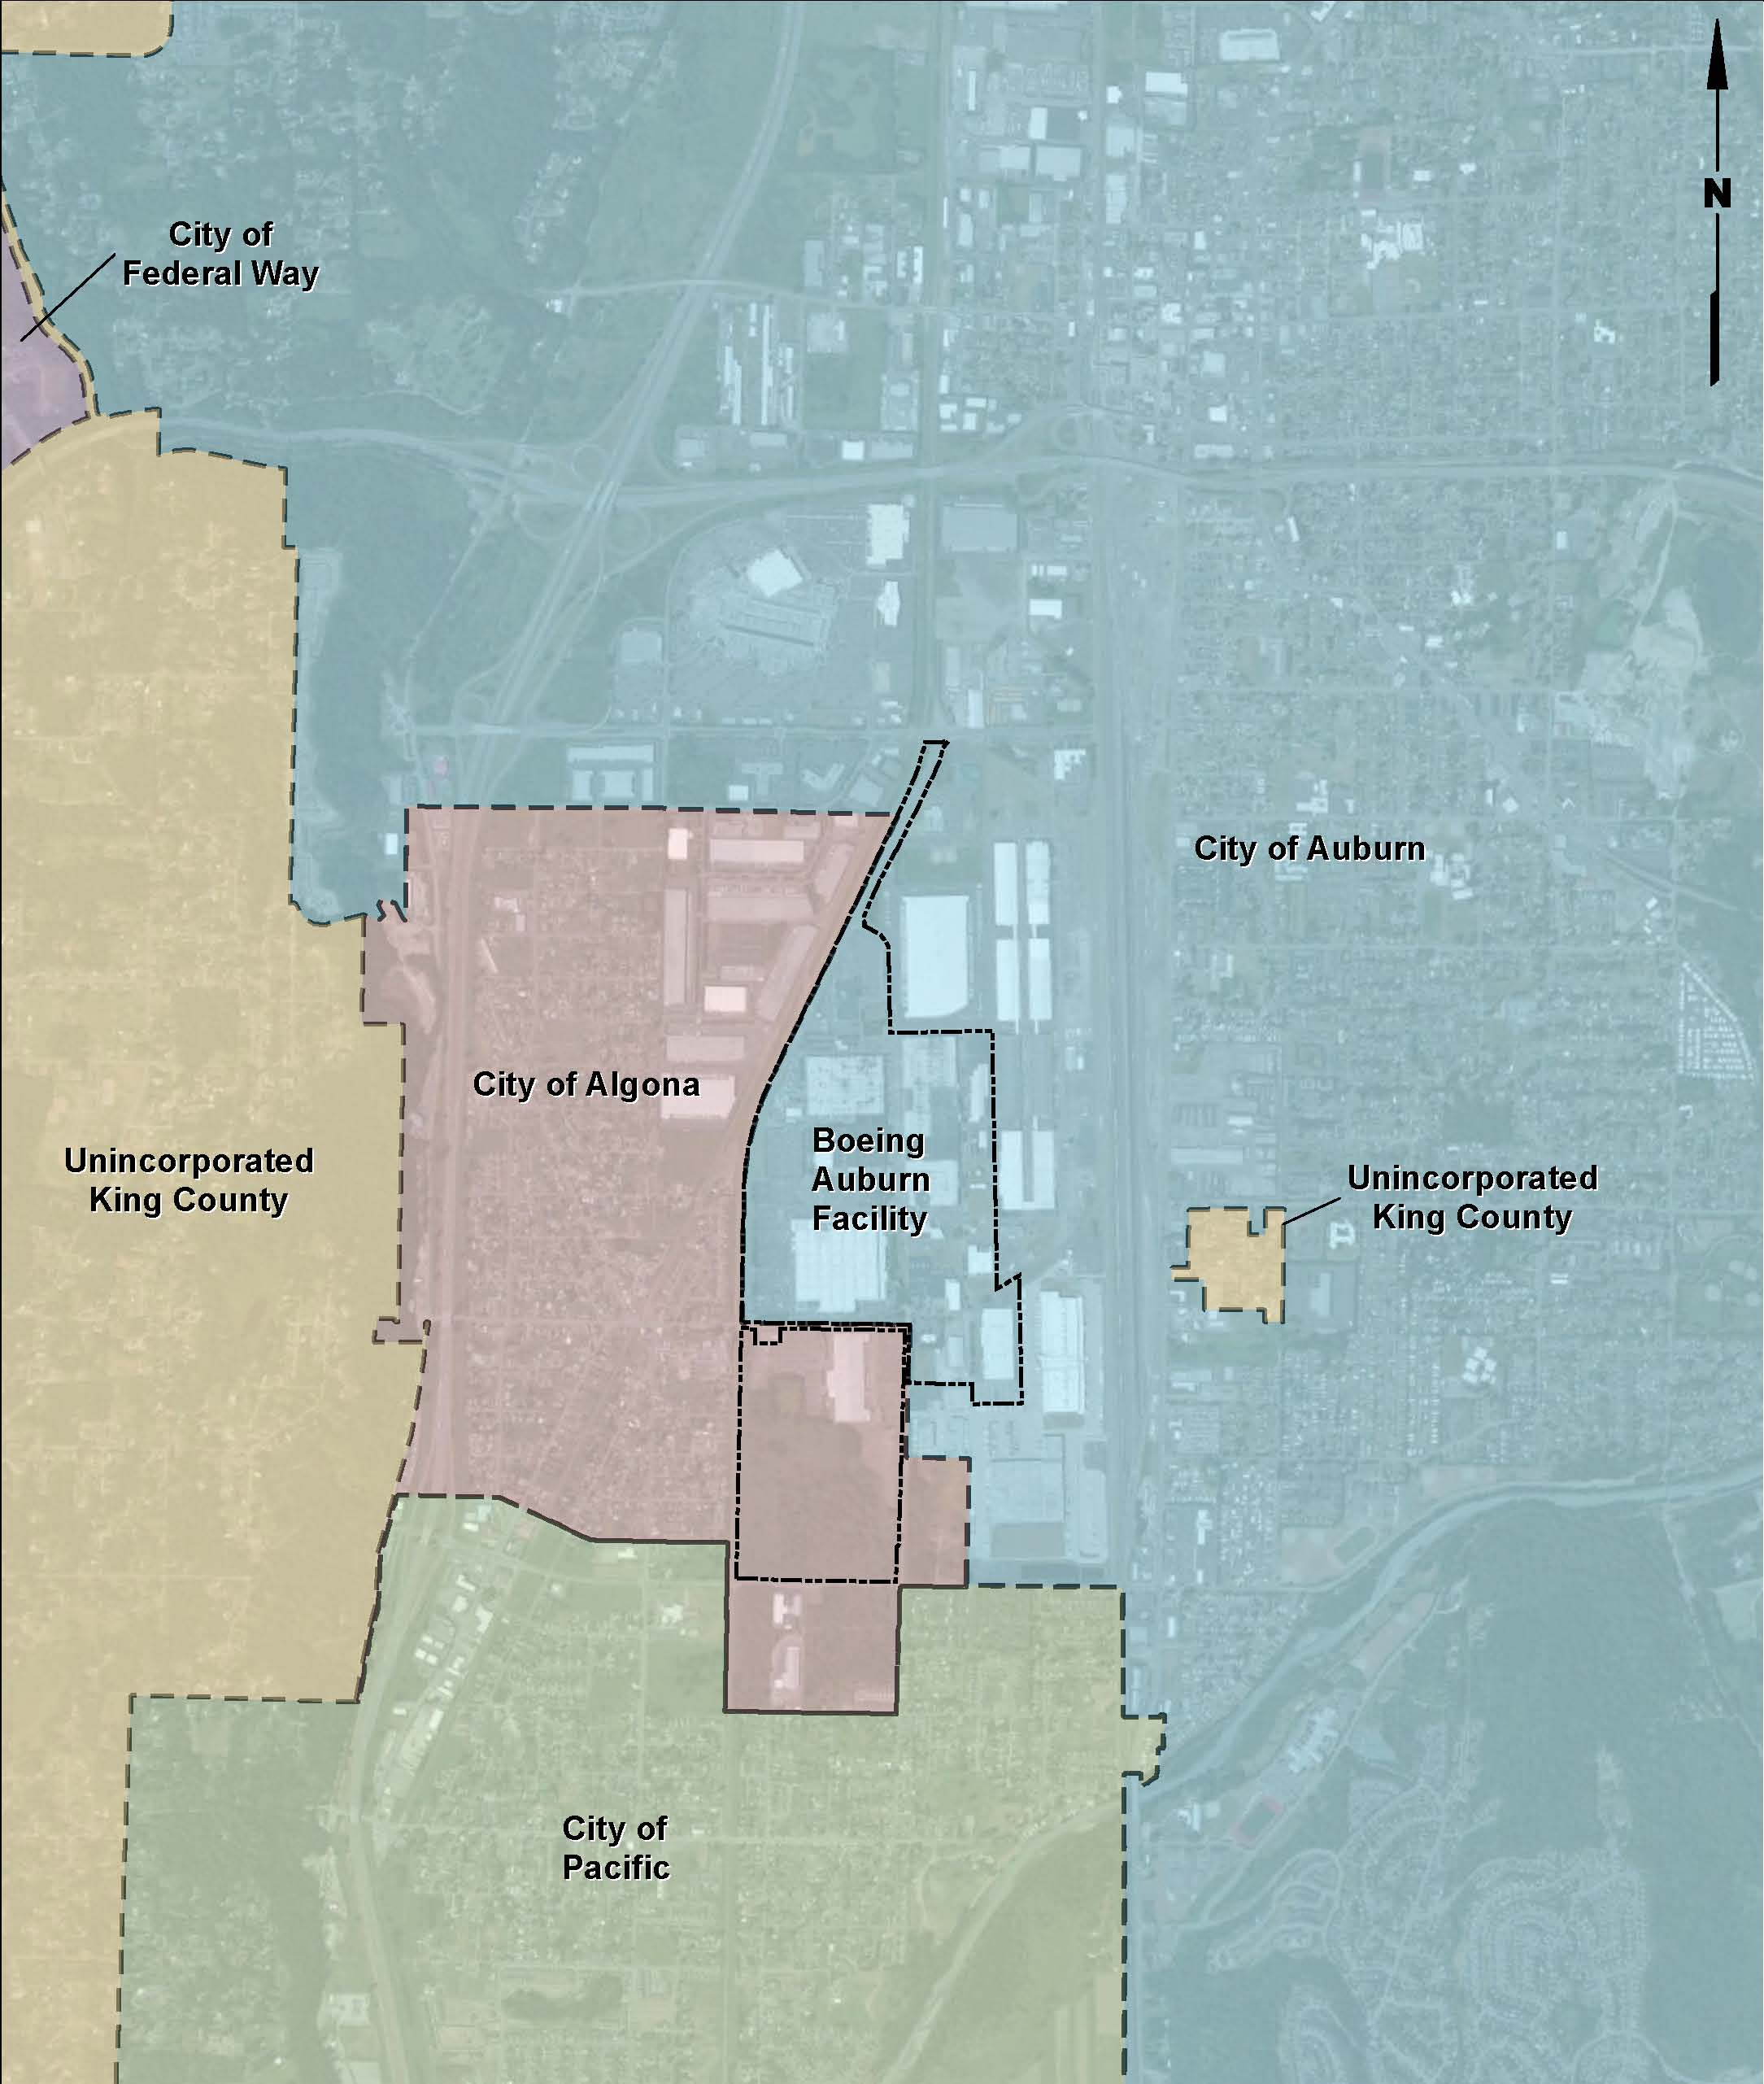
NE Algona Recent and Proposed Future Environmental Investigation in your Neighborhood
Notes:
Slide is on at the beginning of the meeting. No talking Points

Slide 2

Who Are We?
Notes:
Ecology wants to thank Mayor Hill for arranging this meeting, and thank the Filipino Community for allowing us the use of your community hall. We have information for you about an investigation that is being planned for the north Algona neighborhood. So, thank you all for coming to this meeting.
If has not happened already: (Please introduce yourselves, then I will introduce myself at the end.)
My name is Robin Harrover – I am the State Dept. of Ecology Site Manager. I provide state oversight of cleanup at the Boeing Fabrication Auburn Site. My role is to ensure that the cleanup meets the State cleanup requirements. I have a brief presentation to give, then there will be time for your questions at the end.
The State Department of Health is also represented here. The Department of Health ensures that state health standards are met.

Slide 3
Why Are We Here?
Two Laws require cleanup of contaminated soil, water and air at active industrial sites:
1)The Federal RCRA
(Resource Conservation and Recovery Act)
2)The State MTCA
(Model Toxics Control Act)
Notes:
Boeing manages dangerous wastes at the Boeing Fabrication Auburn site. Past practices at industrial sites were not what they are today. At Boeing there have been historical releases of chemicals. We know that at several locations these releases have mixed with groundwater and have spread over time with the flow of groundwater beyond the Auburn Plant boundaries.
The main contaminant found in the groundwater is TCE, or trichloroethylene, which is a solvent that was used to clean manufactured metal and electronic components prior to assembly. We have more information about this chemical and a related chemical, Vinyl Chloride, which forms as TCE breaks down in the environment. You’ll find this information as a hand-out on the table.
The groundwater contamination appears to have originated from two on-site locations. One was the former Building 17-05, which was located along the northeastern portion of the site and housed equipment used for cleaning manufactured parts. Boeing continues to try to identify the source of another low-level TCE plume that appears to have originated from the western part of the site — Boeing no longer uses TCE in it’s processes; therefore, the release may have been from historical operations.
At both locations, it is believed that TCE leaked into shallow groundwater and moved down-gradient with the groundwater toward the north-northwest. The two plumes eventually merged to form one larger plume that ends more than a mile beyond the north-northwest property boundary, and is currently beneath City of Algona commercial property and the Auburn Super Mall.
Monitoring on and around the Auburn site so far indicates that TCE contamination in the groundwater is at low levels of between less than 1 and 13 parts per billion. For comparison, the federal drinking water standard for TCE in public water systems is 5 parts per billion.

Slide 4
This Site is a State Supervised Cleanup Site
Boeing is paying for the site cleanup including the investigations taking place in your area
Notes:
We are here because Ecology is the state agency overseeing how cleanup proceeds at the Boeing Fabrication Auburn site. We are also here because Federal and State Law requires this cleanup.
But I want to be clear: this is a State-led clean-up under the Resource Conservation and Recovery Act. The state also uses the Model Toxics Control Act, a law that resulted from voter-approved initiative in 1989, to guide the process and set the cleanup standards for the site.
This is not a Federally-listed Superfund Site or a federally led cleanup. This means that the State has been authorized as the lead agency to oversee clean-up at this site. Although, the EPA does have the authority to oversee Ecology’s work with Boeing. It also means this site is not on the Federal National Priorities List and therefore does not qualify for recovering costs from the Federal Superfund.

Slide 5
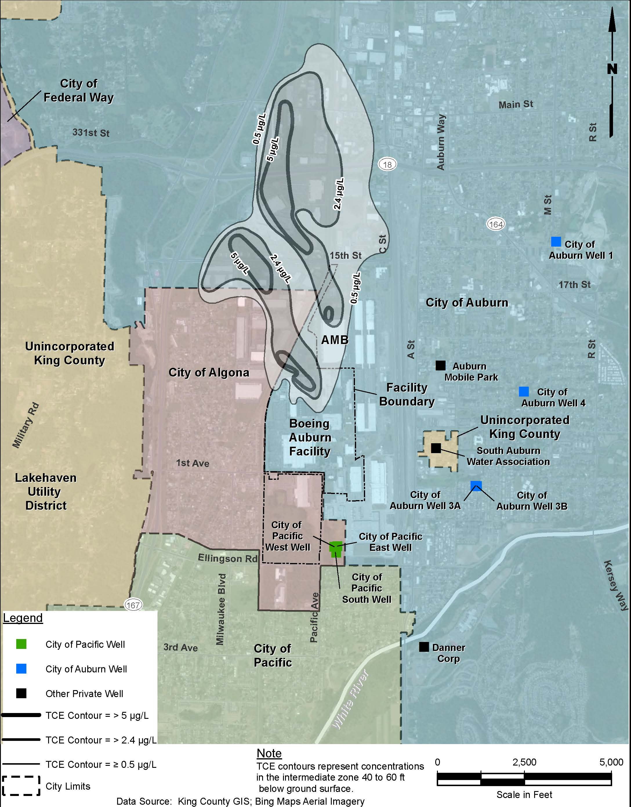
Figure of Drinking Water Well locations relative to known plume extent
What do we know?
Notes:
The drinking water in Algona, Pacific and Auburn is safe for residents to drink. We know that residents of the cities of Algona, Pacific and Auburn are not drinking contaminated groundwater that originated from the Boeing Auburn Plant.
We know this because: The City of Auburn municipal supply wells are located at a greater depth than the depth of this plume, and are below the Osceola Mudflow which is a clay layer that protects the lower aquifer from contaminants migrating down to the depths of the City of Auburn supply wells. The City of Algona obtains its water from the City of Auburn. And, essentially, the groundwater flow is away from the City of Pacific wells. Also, there are sentry wells which are monitored on a semi-annual basis near the City of Pacific wells and the results are reported to the City of Pacific.

Slide 6
Timeline
1966 to mid-1980s: TCE used at the facility
1987 to 1998: Facility permit issued for waste management; facility assessment conducted related to waste management practices; TCE release documented at Area 1
2002: Ecology and Boeing sign Agreed Order; public notice issued
2003-2005: Remedial investigations begin at facility and interim cleanup action completed at Area 1
Notes:
Ecology has been overseeing cleanup at the Boeing Auburn Site for over a decade. Many important milestones have been reached during this time. Ecology’s original Agreed Order requiring Boeing to clean up the site was issued in Spring of 2002, with a fact sheet and public notice. The original Agreed Order was amended and re-issued in 2006, with a fact sheet and public notice. Other cleanup actions have taken place at the site, with a fact sheet and public notice. For example, from 2004 through 2005, Ecology approved and Boeing initiated an interim cleanup action that allowed the AMB Distribution Center to be built where it is now. In 2009, Ecology approved groundwater testing that Boeing completed which, step-by-step over time, has revealed that contamination extends beyond the plant property boundary. Ecology has also kept local officials informed of the progress of the investigations, in particular at a meeting in November 2011.

Slide 7
Timeline Cont.
2006-2009: Agreed Order amended and public notice issued; AMB distribution center constructed in Area ; onsite groundwater investigation conducted
2009-2013: Second TCE plume and offsite groundwater impacts discovered; seven groundwater investigation programs completed to investigate source of the second plume and offsite groundwater impacts
2011-2012: WDOH Health Consultation completed and Ecology focus sheet published; notification to interested local municipalities and water districts
Notes:
Ecology has been overseeing cleanup at the Boeing Auburn Site for over a decade. Many important milestones have been reached during this time. Ecology’s original Agreed Order requiring Boeing to clean up the site was issued in Spring of 2002, with a fact sheet and public notice. The original Agreed Order was amended and re-issued in 2006, with a fact sheet and public notice. Other cleanup actions have taken place at the site, with a fact sheet and public notice. For example, from 2004 through 2005, Ecology approved and Boeing initiated an interim cleanup action that allowed the AMB Distribution Center to be built where it is now. In 2009, Ecology approved groundwater testing that Boeing completed which, step-by-step over time, has revealed that contamination extends beyond the plant property boundary. Ecology has also kept local officials informed of the progress of the investigations, in particular at a meeting in November 2011.

Slide 8
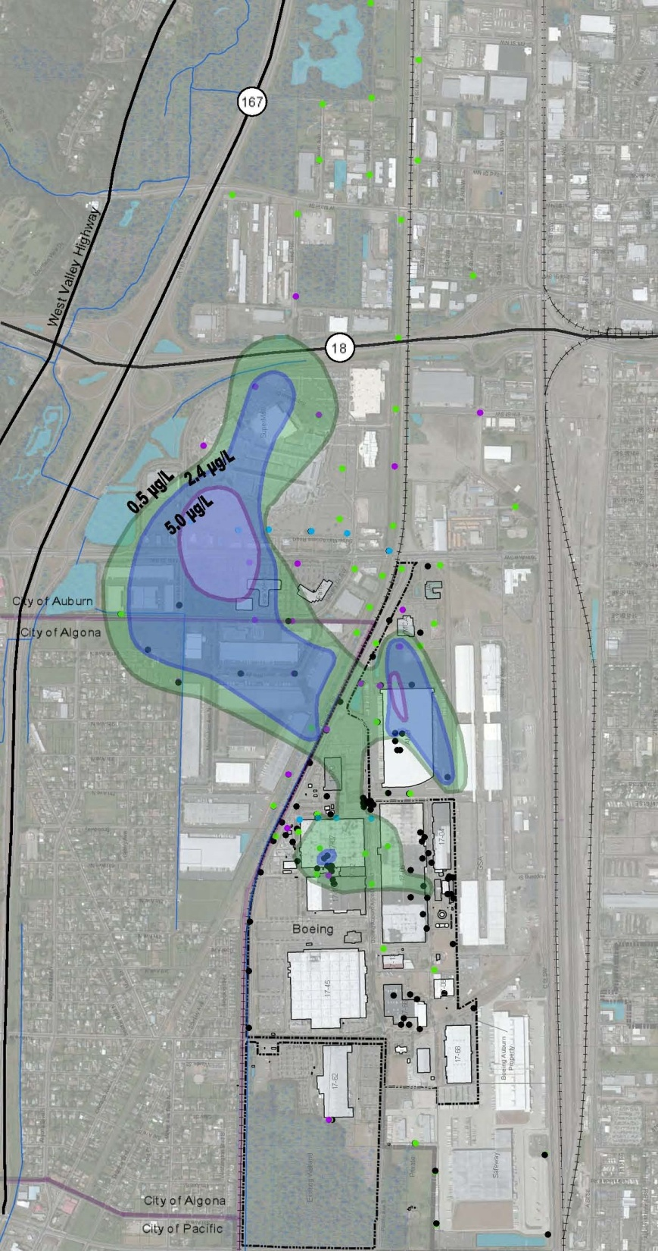
Where are we now?
Notes:
This is the current known extent of the TCE plume in the shallow aquifer zone. While the current known extent appears all at once on this slide, I want to emphasize that the investigation takes some time to arrive at this knowledge. Note that the TCE plume extent is now known to be present in the northeast corner of the Algona residential area.

Slide 9
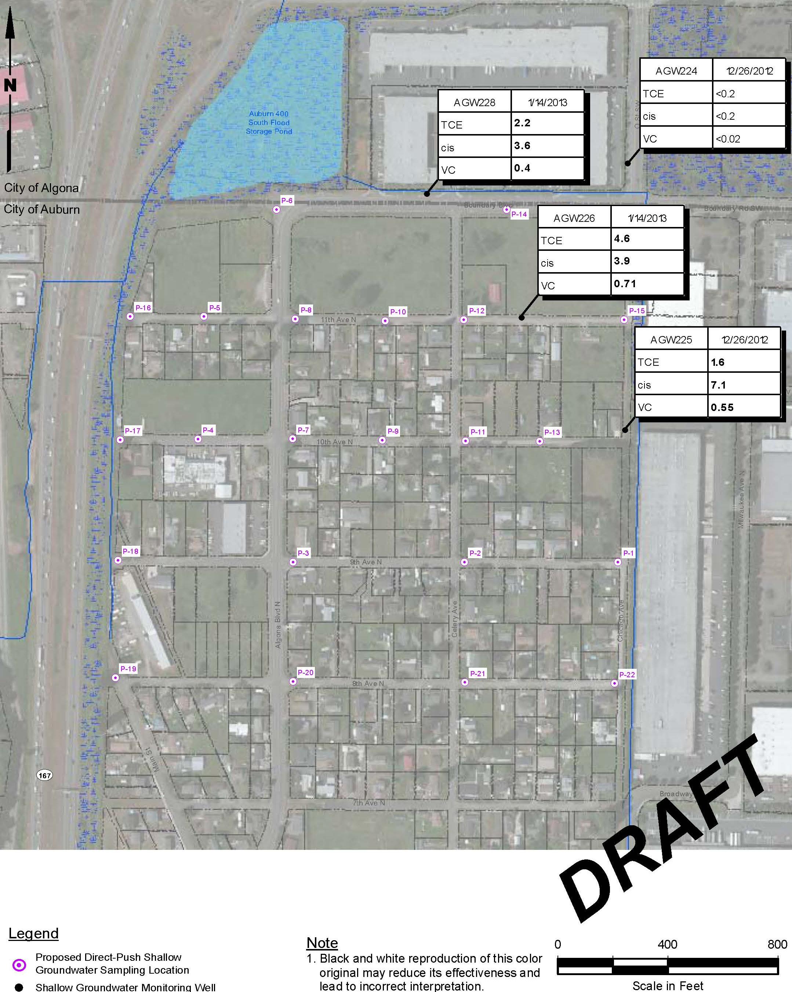
December 2012 Groundwater Sampling Results Indicate More Groundwater Testing Is Needed
Notes:
In mid-January, Ecology received notification of the results of recent testing from groundwater monitoring wells that were sampled in December. These wells are located in North Algona and also just north of the Algona city boundary with Auburn.
The results in well AGW226 (at 4.4 ug/L) are above state cleanup standards that are set at 4.0 ug/l to protect groundwater as a source of drinking water. The results indicate that more sampling needs to be done in the neighborhood near well AGW226. I now want to introduce Jennifer Wynkoop, who works for the consulting firm, Landau and Associates. Jennifer is the Senior Project manager that carries out the environmental investigation work being done for Boeing.

Slide 10
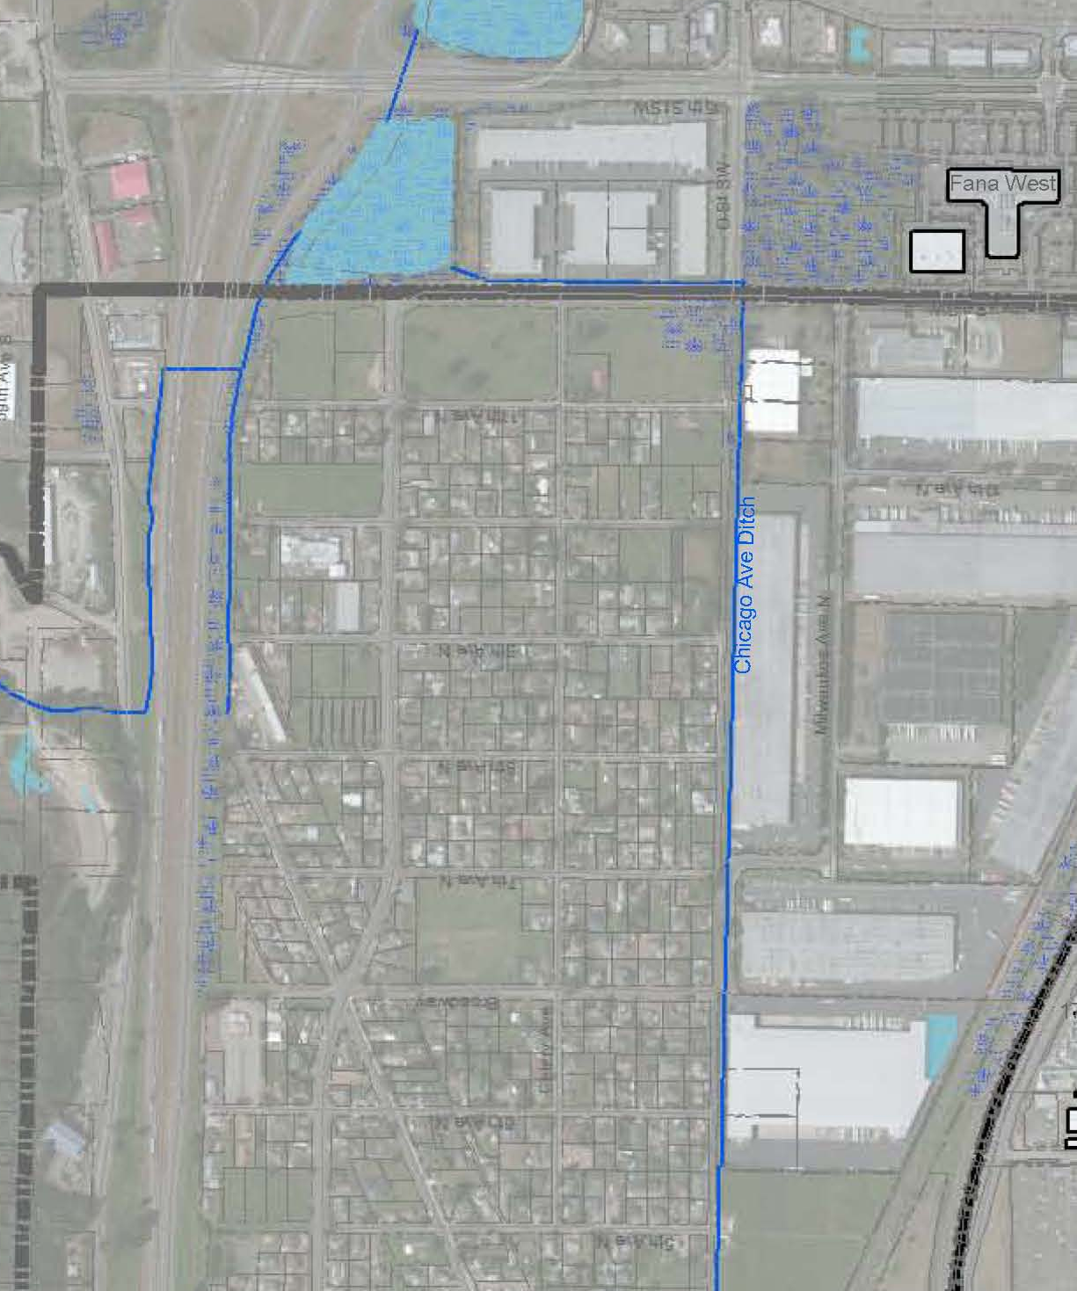
Additional Groundwater Investigation
Collect shallow groundwater samples
Evaluate groundwater conditions
Proposed sample locations
Draft
Existing Shallow Well Location
Proposed Sample Location
Notes:
Hello, I am Jennifer Wynkoop – Boeing’s consultant conducting the investigations near your neighborhood.

Slide 11
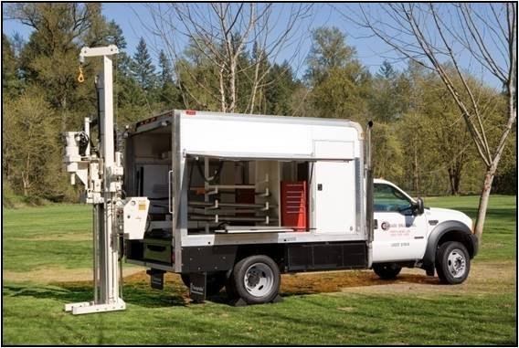
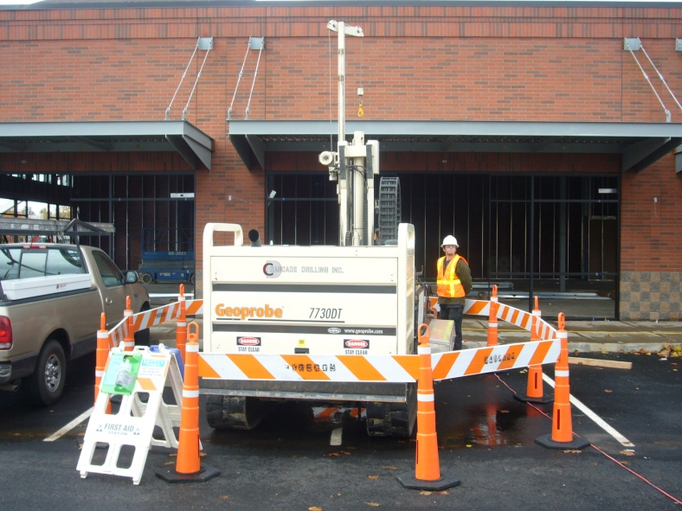
What Will the Drilling Involve?
Location of work
Public safety
1 to 2 hours per location
Access
Noise
Patching the holes
Photos courtesy of Cascade Drilling
Notes:
Jennifer discusses the items on this slide.

Slide 12
Timing and Next Steps
Drilling work is tentatively scheduled for the week of March 11 through 15, 2013
Results will be made available on the Ecology website
Notes:
After sampling is complete, it generally takes the lab several weeks to report validated data to Boeing. Then Boeing needs to check for errors before the data is reported to Ecology.

Slide 13
What Happens After the Groundwater Investigation?
  Based on groundwater data results and state cleanup standards, Ecology identifies homes for building surveys and indoor air sampling
  The next public meeting is tentatively scheduled for May 2013 after the final test results have been evaluated by Ecology, DOH and the City
Notes:
When Ecology receives the finalized data from Boeing, the next step is to evaluate the data. Boeing will evaluate the data and propose the next steps to Ecology in a Report. Ecology, the DOH, and the Cities review, evaluate and comment on the report. After the comments have been accepted and the proposed next steps are approved in a work plan, Ecology will host another meeting. This process takes a few months, which is why Ecology’s next meeting with the community isn’t planned until May 2013.
Boeing will make recommendations to Ecology about which homes need to have indoor air samples collected and tested. Ecology will evaluate Boeing’s proposed plan, negotiate any needed changes, and approve the final plan.

Slide 14
Why Sample Indoor Air?
  Some of the TCE in the groundwater may volatilize (become vapor) and move upwards through the soil and into a building’s indoor air.
  This is called “vapor intrusion.”

Slide 15
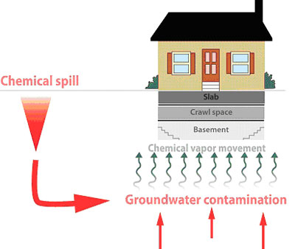
Chemical Spill
Groundwater Contamination

Slide 16
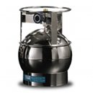
HOW do we determine if vapor intrusion may be contaminating indoor air?
  we look at the groundwater concentrations
  we look at the depth to the water table
  we look for points of entry and building design
  we use this information to make decisions about where to collect soil gas(sometimes), indoor air, and/or crawlspace air samples
Notes:
There are many factors which determine whether vapor intrusion will occur, and whether once it does occur, it will build up in the home to unhealthy levels.
Some of these factors include cracks in the foundation; unsealed utility lines into the home; and design of the home…Basements, un-ventillated crawl spaces and cracked concrete slabs located a short distance above contaminated groundwater can all allow contaminant concentrations to build up under the home, or provide pathways of entry into the home.
Good ventillation of the home can prevent vapor intrusion from concentrating to unhealthy levels in indoor air.

Slide 17
Why Sample Indoor Air In Algona?
    The levels of TCE contamination we have found at two locations in Algona’s shallow groundwater are very low, below the Federal Drinking Water standard
    However, the groundwater table in at least some areas of Algona is very shallow.
    So we will recommend testing indoor air in those homes where there is TCE at the shallow groundwater table at concentrations above the health risk-based screening level.

Slide 18
Important Points to Consider
  Allowing indoor air sampling is voluntary
  Indoor air sampling costs are paid by Boeing
  Indoor air sampling can set your mind at ease if results are below state cleanup levels
  Indoor air sampling results that are of concern lead to mitigation measures paid for by Boeing that will protect your health

Slide 19
How to stay informed?
Contact the Site Manager Robin Harrover:
3190 160th Ave SE
Bellevue, WA 98008
Phone Number: 425-649-7232
Email Address: Robin.Harrover@ecy.wa.gov
Visit our Ecology’s Boeing Fabrication Auburn website: https://fortress.wa.gov/ecy/gsp/Sitepage.aspx?csid=5049

